Slide 1
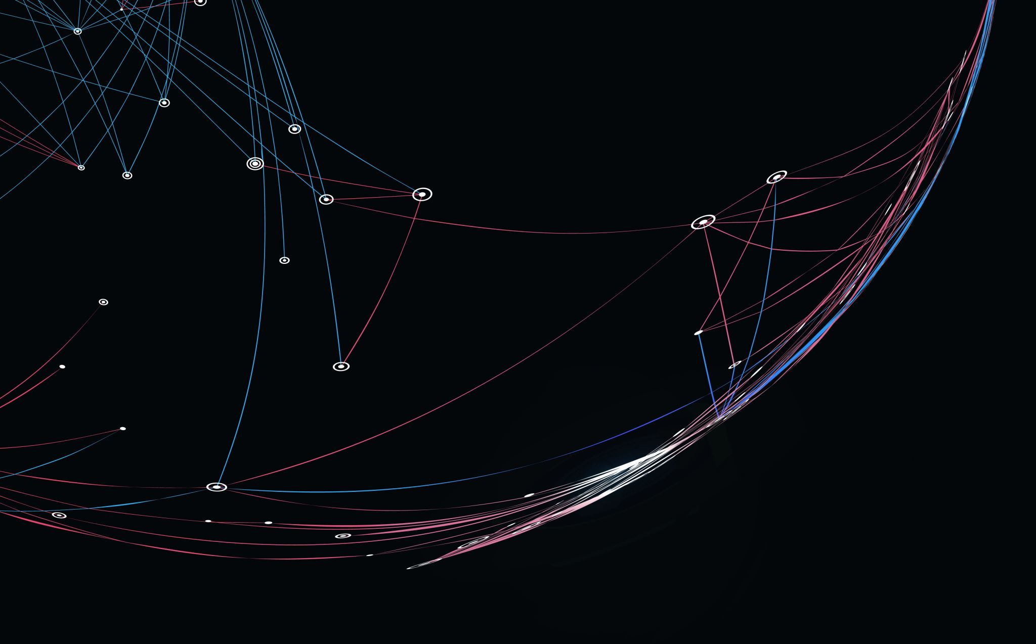
Group Zekuip
Ezekiel Sandor, Jacopo Bulgarelli, Jacopo Gentile, Thomas Colangelo

Slide 2

Dataset
The data has the following attributes:
country: Name of the country
child_mort: Death of children under 5 years of age per 1000 live births
exports - Exports in % age of the GDP per capita
health - The total spend on health given as % of GDP
imports - The value of imports given as % of GDP per capita
income - The net income per person
inflation - Inflation rate %
life_expec - Average life expectancy in years
total_fer - The fertility rate - Average children per woman in the country
gdpp - GDP per capita

Slide 3
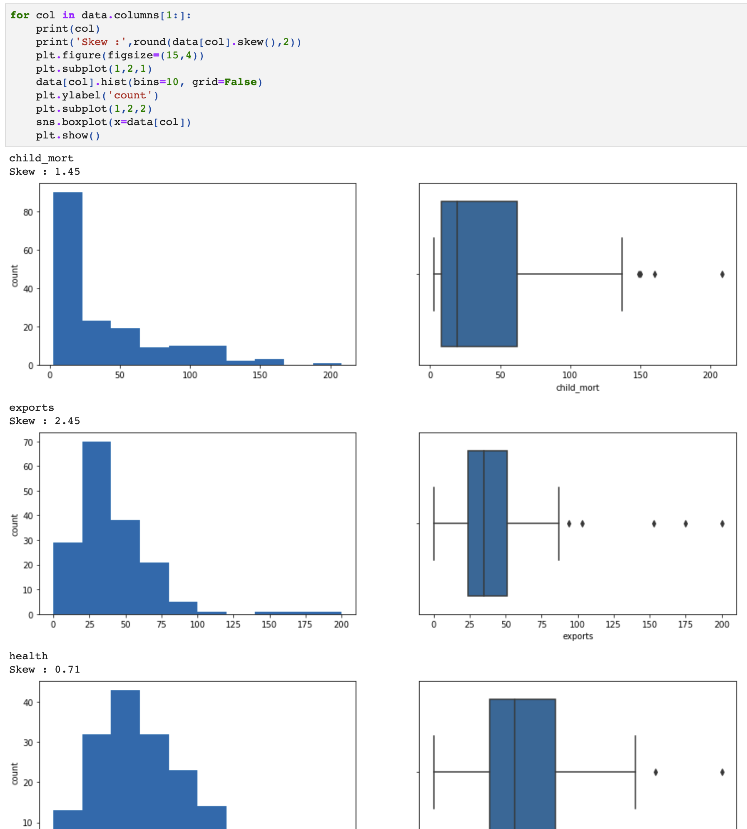
Research questions
While GDP is one of the most popular measure used in socio-economical analysis, it is not the only measure of the growth and the state of an economy.
Here we analyzed the skewness of the different variables and created the relative boxplots.

Slide 4
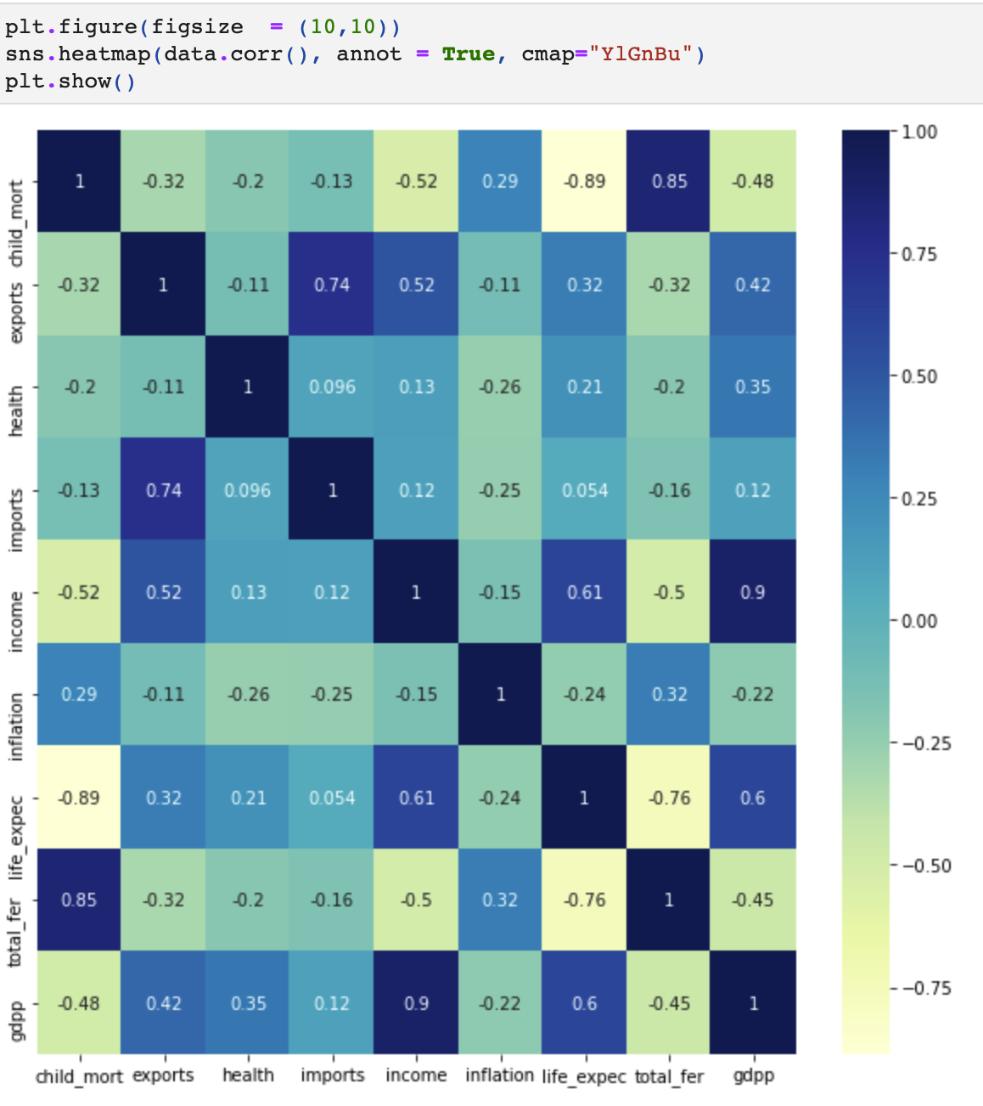
Research Question
We wanted to analyze the other factors, such as life expectancy, inflation, health etc. in order to have a deeper understanding. Through EDA and statistical analysis we also want to see the relationship between these variables.
Here for example we looked for the correlation between all variables.

Slide 5
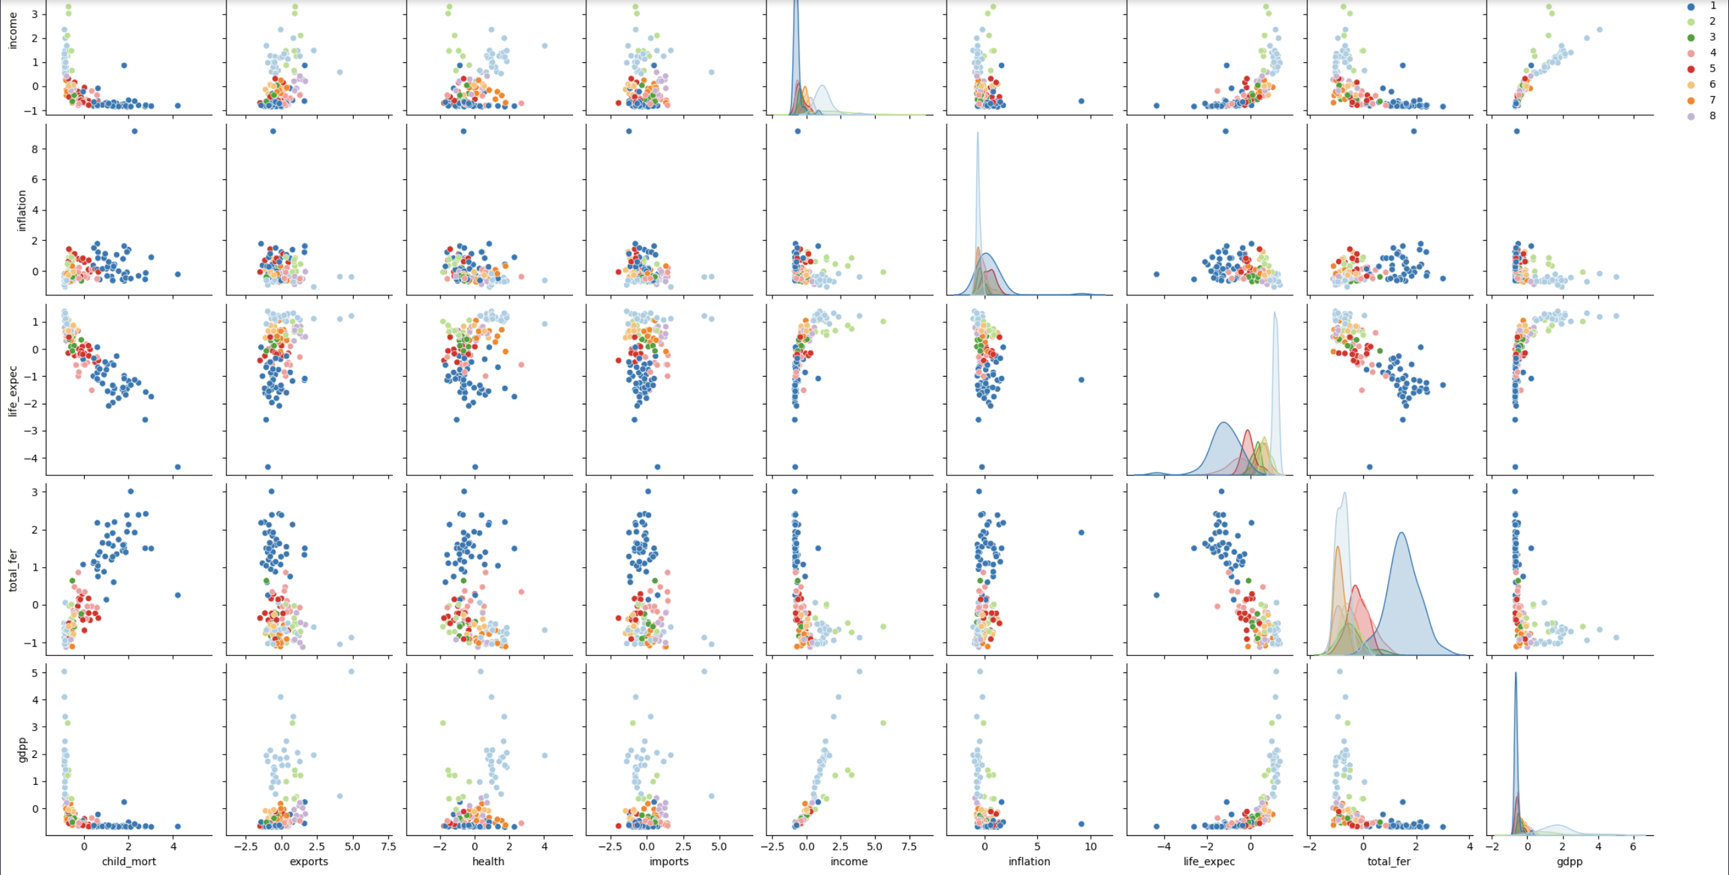

Slide 6

Stakeholder
Study of socio-economic factors is foundational to understand and shape the future of societies, hence it is of extreme interest to various government and non-government institutions, such as universities and non-profit organizations.

Slide 7



What we’re gonna use

